Slide 1

Project : Boston House Price Prediction Analysis
Final Project Presentation , In partial fulfillment of the final project of ML course (109449-MGT-665-MA1) Submitted by Mohammad Nasim
Intellectual Property - DeVos Graduate Sch.
Northwood University
4000 Whiting Drive Midland, Michigan, USA
Guide : Dr. Itauma, Itauma
Division Chair & Assistant Professor
Graduate Academic, Northwood University

Slide 2
Why House-Price Prediction?
Real Estate Agents:
Homebuyers:
Real Estate Investors:
Homebuyers use house price predictions to make informed decisions about purchasing a home. By knowing the potential future value of a property, they can make better decisions about when and where to buy a home.
Real estate agents use house price predictions to advise clients on pricing their homes or properties for sale. They can also use predictions to advise clients on when to sell or buy property, and what type of property to invest in.
Real estate investors use house price predictions to make informed decisions about buying or selling property. Predictions can help investors identify undervalued properties, as well as properties with potential for growth.
Mortgage Lenders: Mortgage lenders use house price predictions to determine the value of a property and assess the risk associated with a loan. This helps lenders determine the amount of financing they are willing to offer to potential buyers.
Government: Governments use house price predictions to inform policy decisions related to housing, including housing affordability and housing supply. They can also use predictions to monitor the health of the housing market and identify potential risks.

Slide 3
LITERATURE REVIEW
Borde, S., Rane, A., Shende, G., & Shetty, S. (2017). Real estate investment advising using machine learning. International Research Journal of Engineering and Technology (IRJET), 4(3), 1821.
Trawinski, B., Telec, Z., Krasnoborski, J., et al. (2017). Comparison of expert algorithms with machine learning models for real estate appraisal. In Proceedings of the 2017 IEEE International Conference on INnovations in Intelligent SysTems and Applications (INISTA).
Kontrimas, V., & Verikas, A. (2011). The mass appraisal of the real estate by computational intelligence. Applied Soft Computing, 11(1), 443-448.
Woźniak, M., Graña, M., & Corchado, E. (2014). A survey of multiple classifier systems as hybrid systems. Information Fusion, 16, 3-17.
Barr, J. R., Ellis, E. A., Kassab, A., Redfearn, C. L., Srinivasan, N. N., & Voris, K. B. (2017). Home price index: A machine learning methodology. International Journal of Semantic Computing, 11(1), 111-133.
McCluskey, W. J., McCord, M., Davis, P. T., Haran, M., & McIlhatton, D. (2013). Prediction accuracy in mass appraisal: A comparison of modern approaches. Journal of Property Research, 30(4), 239-265.
Rosen, S. (1974). Hedonic prices and implicit markets: Product differentiation in pure competition. Journal of Political Economy, 82(1), 34-55.
Lughofer, E., Trawiński, B., Trawiński, K., Kempa, O., & Lasota, T. (2011). On employing fuzzy modeling algorithms for the valuation of residential premises. Information Sciences, 181(23), 5123-5142.
Kusan, H., Aytekin, O., & Özdemir, I. (2010). The use of fuzzy logic in predicting house selling price. Expert Systems with Applications, 37(3), 1808-1813.
Bin, O. (2004). A prediction comparison of housing sales prices by parametric versus semi-parametric regressions. Journal of Housing Economics, 13(1), 68-84.

Slide 4
LITERATURE REVIEW ASSESSMENT
The mentioned ten LITERATURES related to real estate appraisal and prediction using machine learning, fuzzy logic, and regression analysis. The papers cover various topics, such as mass appraisal, prediction accuracy, hybrid systems, and valuation of residential premises. The authors employed several techniques to predict house selling prices, including fuzzy logic, machine learning, and parametric versus semi-parametric regressions.

Slide 5

Problem statement
The goal of this project is to predict the price of a house based on several features such as per capita crime rate ,proportion of residential land zoned, average number of rooms per dwelling, full-value property-tax rate etc. This is a regression problem where we are trying to predict a continuous value (house price) using machine learning.

Slide 6
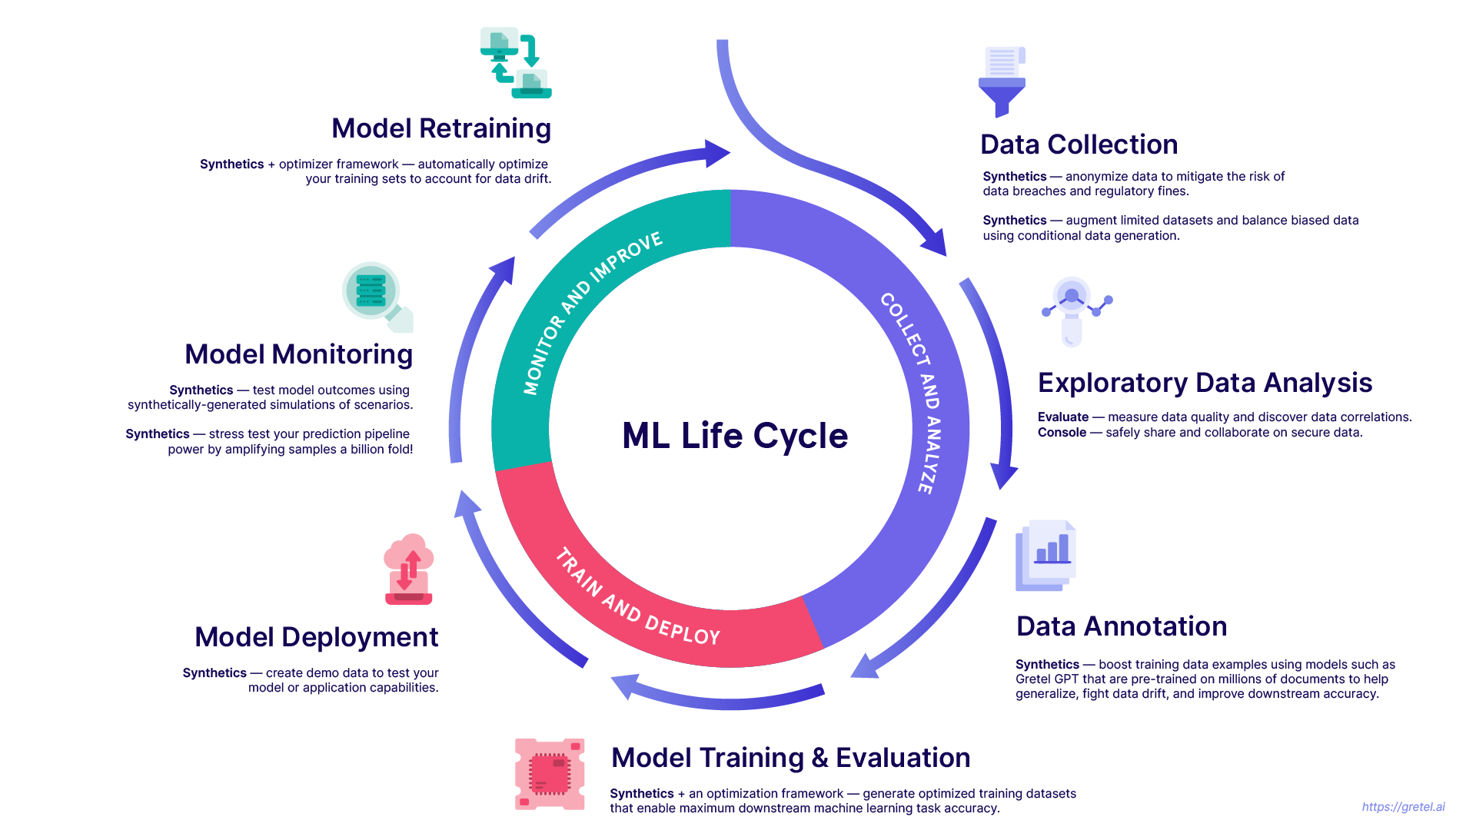
LIFECYCLE TO BUILD A MODEL WITH MACHINE LEARNING

Slide 7

METADATA (Information about Dataset)
The dataset known as the Boston House Prices was gathered in 1978 and comprises 506 records that describe 14 features or characteristics of homes located in different suburbs of Boston.

Slide 8
METADATA (Featurenames and Its description)
FeatureName | Description
CRIM | per capita crime rate by town
ZN | proportion of residential land zoned for lots over 25000 sq.ft.
INDUS | proportion of non-retail business acres per town
CHAS | Charles River dummy variable (= 1 if tract bounds river; 0 otherwise)
NOX | nitric oxides concentration (parts per 10 million)
RM | average number of rooms per dwelling
AGE | proportion of owner-occupied units built prior to 1940
DIS | weighted distances to five Boston employment centers
RAD | index of accessibility to radial highways
TAX | full-value property-tax rate per $10000
PTRATIO | pupil-teacher ratio by town
BLACK | 1000(Bk - 0.63)^2 where Black is the proportion of blacks by town
LSTAT | % lower status of the population
MEDV | Median value of owner-occupied homes in $1000's

Slide 9
Action Formula
S
Select
Predict
P
The variable we aim to predict is MEDV, which is equivalent to $1000 for a value of 1
Our task is to predict the outcome variable using 13 input attributes provided.
Data
Analysis
D
G
Discard
Generate
If necessary, we may discard certain attributes that do not contribute to the prediction of the target variable.
Furthermore, we may also generate new attributes from the given attributes.

Slide 10

Import Modules
pandas - used to perform data manipulation and analysis
numpy - used to perform a wide variety of mathematical operations on arrays
matplotlib - used for data visualization and graphical plotting
seaborn - built on top of matplotlib with similar functionalities
%matplotlib - to enable the inline plotting
warnings - to manipulate warnings details
filterwarnings('ignore') is to ignore the warnings thrown by the modules (gives clean results)

Slide 11

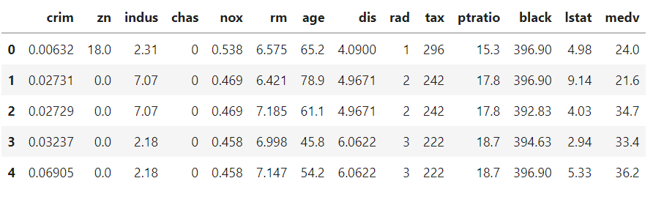
Dataset Loading (Boston Dataset CSV File)
Conclusion : We have dropped the unnecessary column 'Unnamed : 0'.

Slide 12
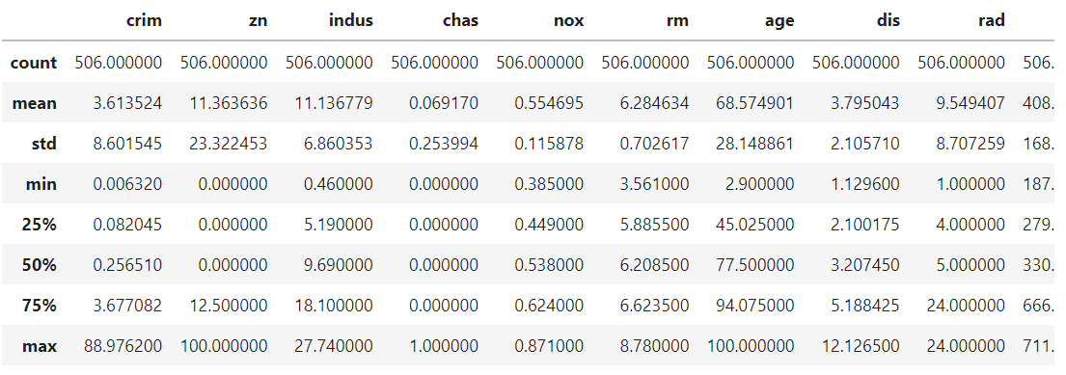
Statistical Information
Conclusion :
There are no NULL values.
All other values are adequate.

Slide 13
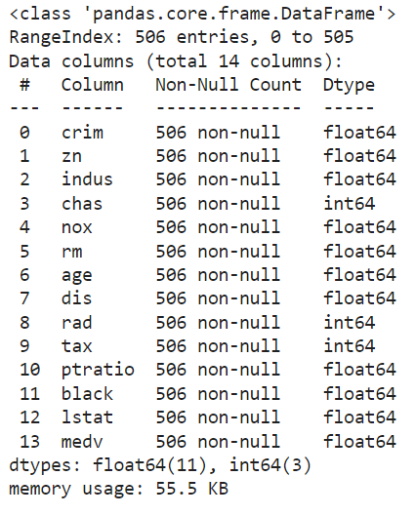
Information of DataTypes
Conclusion :
All the columns are in numerical datatype.
We will create new categorical columns using the existing columns later

Slide 14
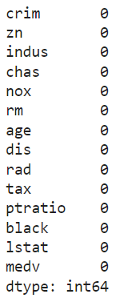
Dataset - Preprocessing
Conclusion : No NULL values were found.

Slide 15
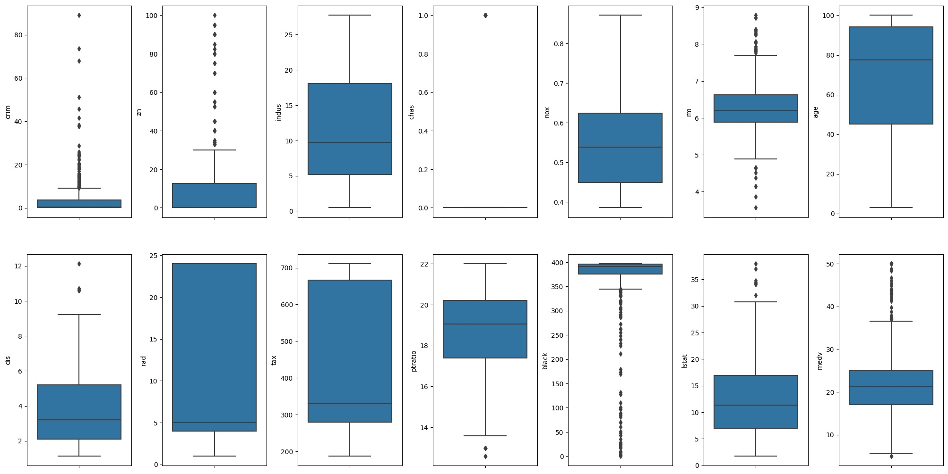
Exploratory Data Analysis
Let us create box plots for all columns to identify the outliers.

Slide 16
Exploratory Data Analysis (EDA)
In the graph, the dots represent the outliers.
‘Crim’, ‘zn’, ‘black’ has so many outliers and does not follow the normal distribution.
The column containing many outliers does not follow the normal distribution.
We can minimize outliers with log transformation or min max normalization
We can also drop the column which contains outliers (or) we can delete the rows which contains the same.

Slide 17
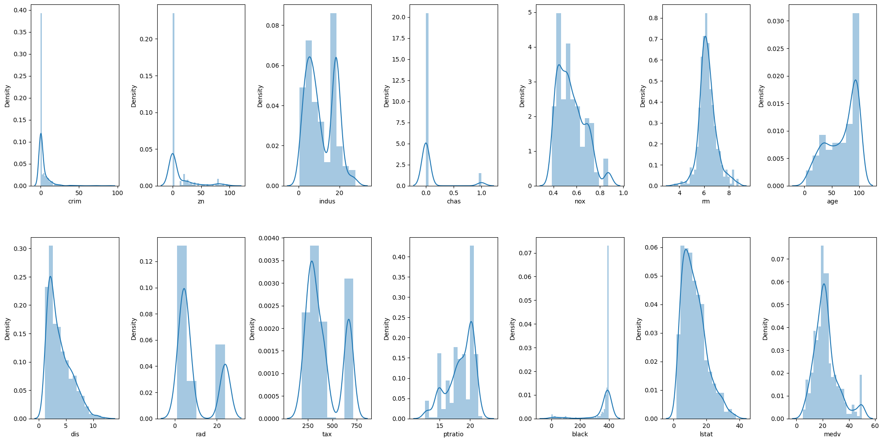
Exploratory Data Analysis (EDA)

Slide 18
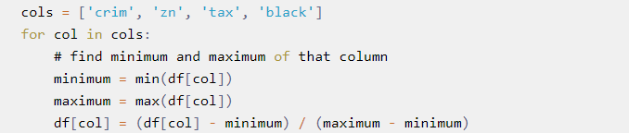
Exploratory Data Analysis (EDA) Min-Max Normalization.
We can observe right skewed and left skewed graphs for 'crim', 'zn', 'tax', and 'black'.
Therefore, we need to normalize these data.
We will create the column list for the 4 columns and use Min-Max Normalization.
The last line shows the formula for min-max normalization.
Now the range of these columns is between 0 to 1.
Min-Max Normalization transformed the maximum value as '1' and the minimum value as '0'.

Slide 19

Min-Max Normalization

Slide 20
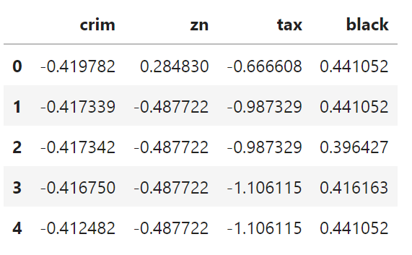
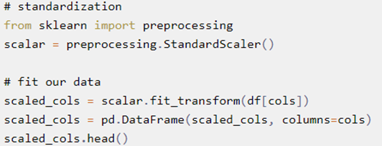
Exploratory Data Analysis (EDA) - Standardization
Standardization uses mean and standard deviation. Here, preprocessing.StandardScaler( ) is the standardization function.
Let us get back to our Original database.
for col in cols: df[col] = scaled_cols[col]
This code will assign the standardized value to the original data frame.
Standardized values.
Even now the columns 'crim', 'zn', 'tax', and 'black' does not show a perfect normal distribution.
However, the standardized value of these columns will slightly improve the model performance.

Slide 21

Standardization Output

Slide 22
Correlation Matrix
We mostly focus on the target variable as this is a Regression problem.
But we can also observe other highly correlated attributes by column 'tax' and 'rad'.
We will later eliminate this correlation by ignoring any of the variables.
Additionally, we will display 'lstat' and 'rm' to show their correlation with the target variable 'medv'.

Slide 23
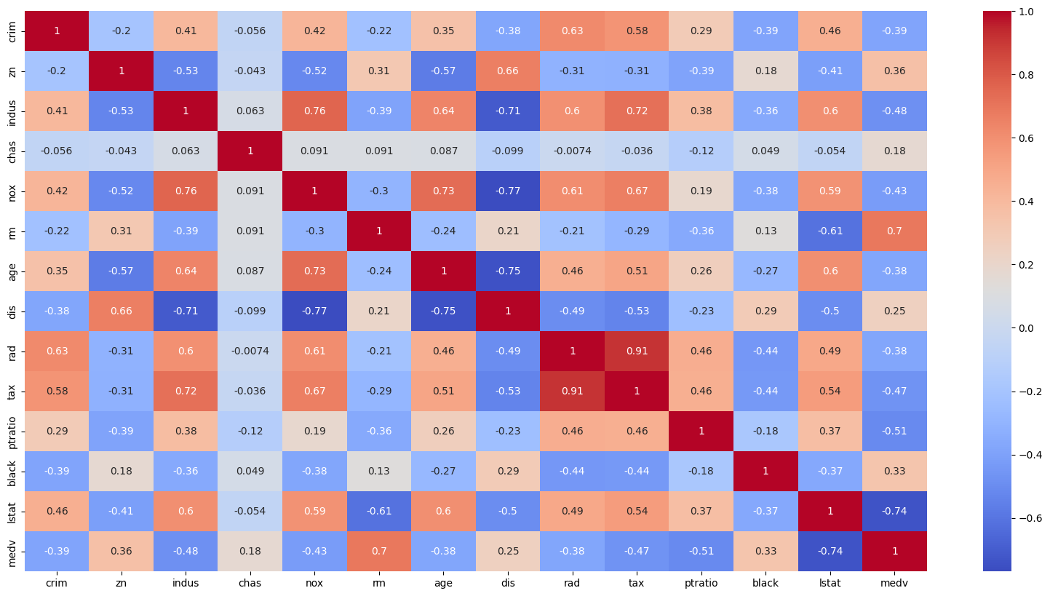
Correlation Matrix

Slide 24
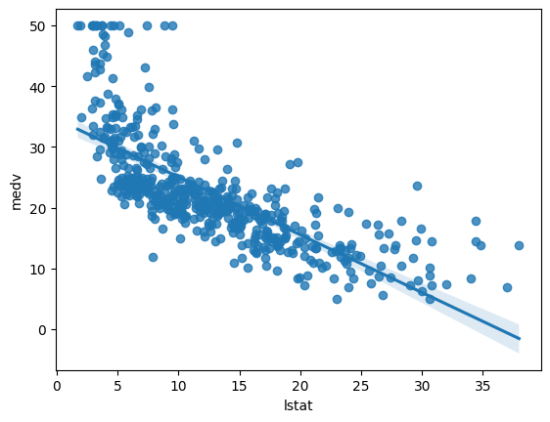
Relation between Target and Correlated Variables
Here, the price of houses decreases with the increase in the 'lstat'. Hence it is negatively correlated.

Slide 25
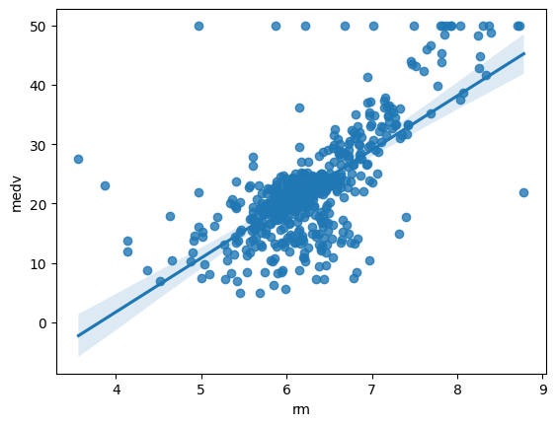
Here, the prices of houses increase with the increase in 'rm'. Hence it is positively correlated

Slide 26
Model Training
Now let's import functions to train models.
Instead of training the whole model, we will split the dataset for estimating the model performance.
If you train and test the dataset completely, the results will be inaccurate. Hence, we will use 'train_test_split'.
We will add random_state with the attribute 42 to get the same split upon re-running.
If you don't specify a random state, it will randomly split the data upon re-running giving inconsistent results.
We use 'cross val score' for better validation of the model.
Here, cv=5 means that the cross-validation will split the data into 5 parts.
np.abs will convert the negative score to positive and np.mean will give the average value of 5 scores.

Slide 27
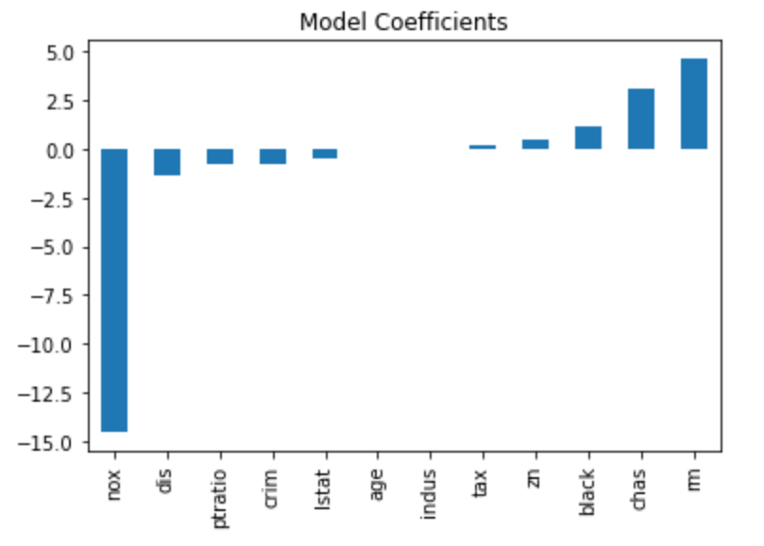
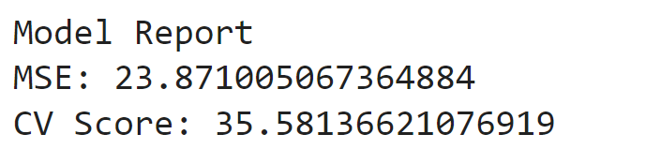
Linear Regression:
Mean Squared Error is around 23 and Cross-Validation Score is around 35.
rm shows a high positive coefficient and nox shows a high negative coefficient.

Slide 28
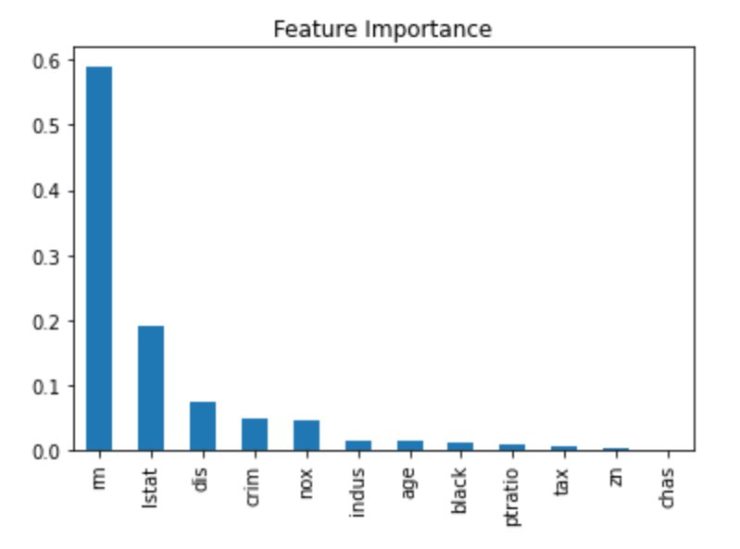
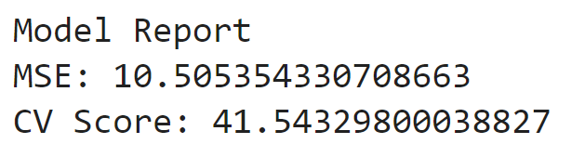
Decision Tree:
Here CV Score is higher than Linear Regression.

Slide 29
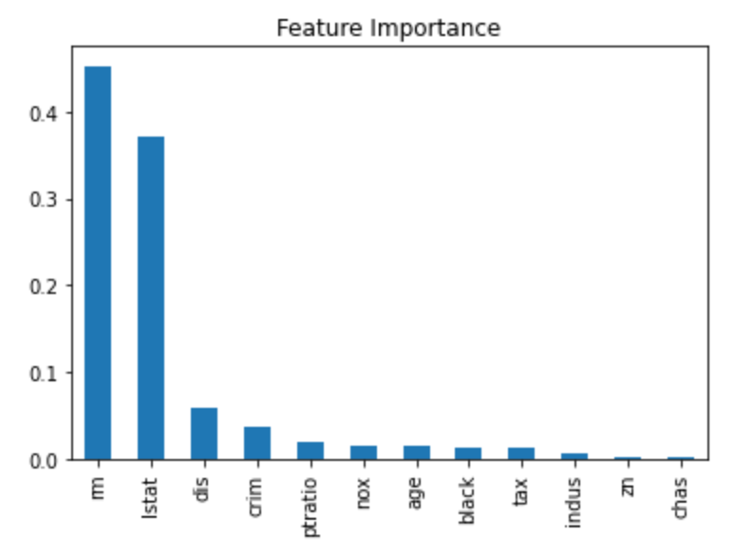
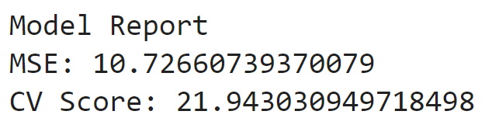
Random Forest:
We know that 'rm' and 'lstat' produces much correlation with the target variable. That is the reason behind its higher feature importance among other attributes.
MSE is around 10 and CV score is around 21.

Slide 30
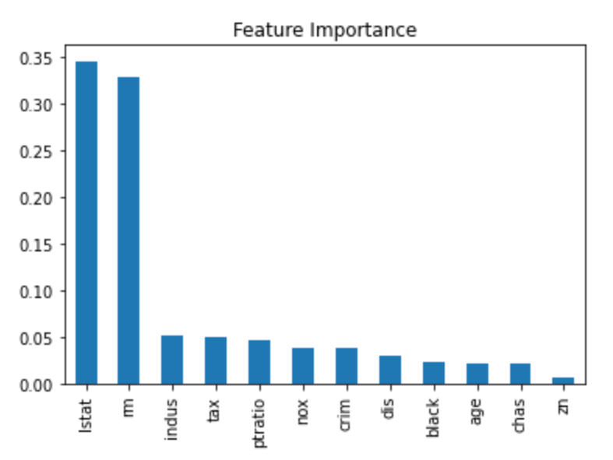
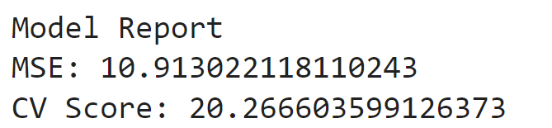
Extra Trees:
Here MSE is similar to Random Forrest and the cross-validation score is decreased.

Slide 31
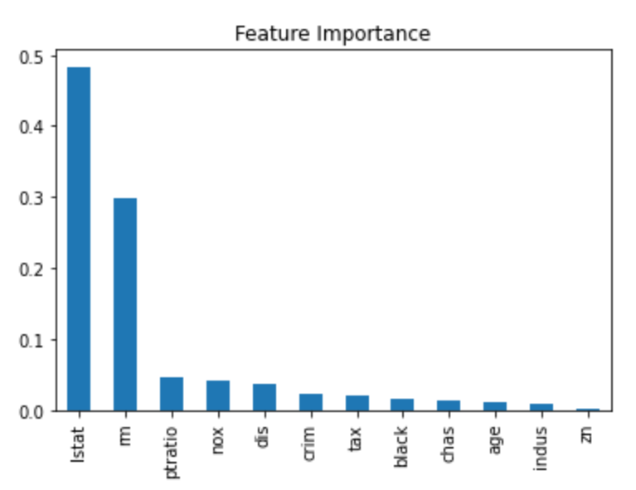
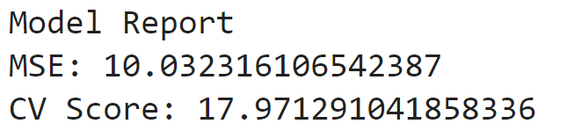
XGBoost:
MSE, as well as CV Score, is the least among all other models.
The XGBoost shows the best result with minimal cross validation error.

Slide 32
Comparison Diagram and Summary :
Decision Tree: Mean Squared Error is around 10 and Cross-Validation Score is around 41.
CV-41
Linear Regression: Mean Squared Error is around 23 and Cross-Validation Score is around 35.
CV-35
Random Forest: Mean Squared Error is around 10 and Cross-Validation Score is around 22.
CV-22
Extra Trees: Mean Squared Error is around 10 and Cross-Validation Score is around 20.
CV-20
XGBoost : Mean Squared Error is around 10 and Cross-Validation Score is around 17.
CV-17
To summarize, XGBoost Regressor works best for this project.
We can further improve the model by creating new attributes and performing hyperparameter tuning.
We can create a new categorical attribute with the help of an existing numerical attributes.

Slide 33
Questions: ??

